Slide 1
“National Excellence” Indicator of a Democratic State
Question no. 1 - Does the state need it ?
Question no. 2 - Does the state know
how to measure it ?
Question no. 3 - Does the state know
its “opportunities for
improvement” ?

Slide 2
National Excellence Indicator (N.E.I)
I1 = RRMC=Real Real Money per Capita
= X/Y="Excellence related Income“ per Capita
= NIS (New Israeli Shekels) per Resident
I2 = 5 Years Move Average compare to 1984

Slide 3
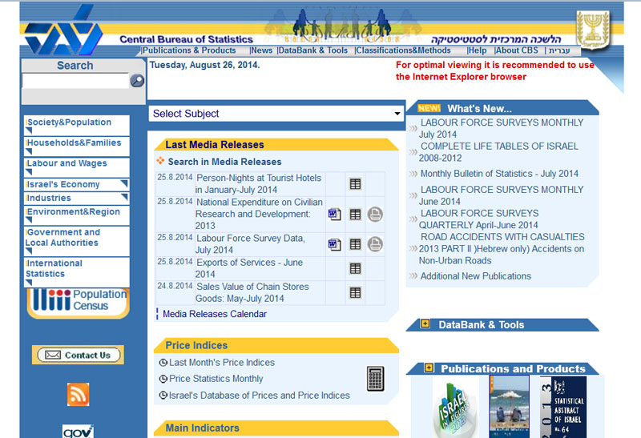

Slide 4


Slide 5
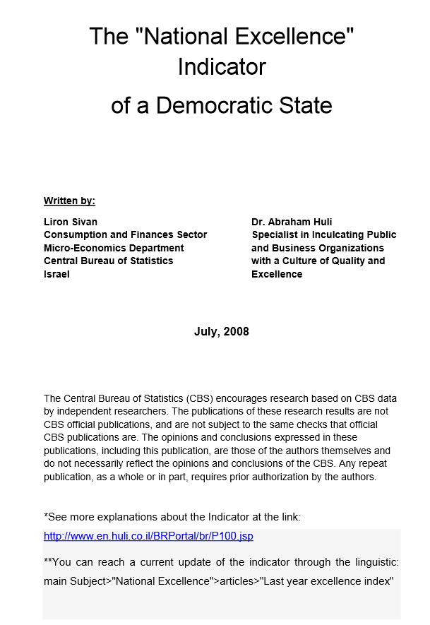

Slide 6
Bibliography
"Management in Government: Moving towards Government at a Glance".
OECD 2006. On the net: www.oecd.org
2. Excellence or Excelling. 2007 [Hebrew] on the net:
www.leadersent.co.il/scripts/glossary/termmprevew.asp
3. Miki Barkal. 2006 "Excellence as an effective habit for a full life" [Hebrew]
on the net: www.articles.co.il/author/1042
4. Arie Ofner. 2007 "Excellence as a business and basic value for national
culture". On the net: www.incetweek.co.il/articledetails

Slide 7
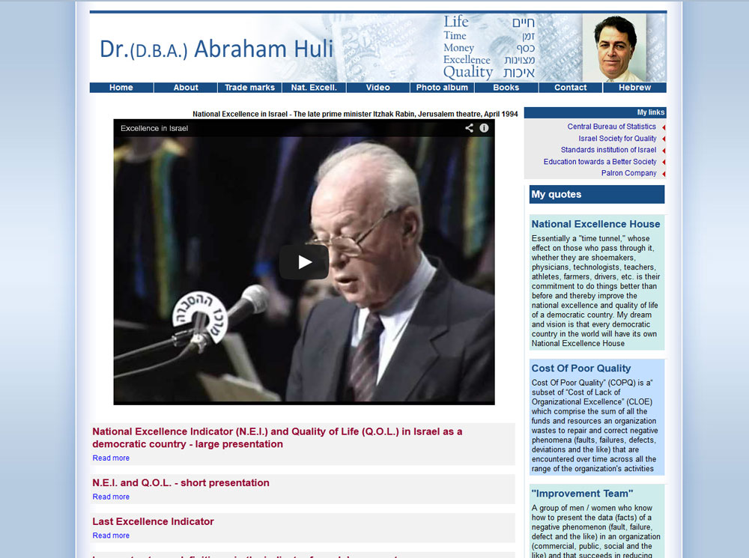

Slide 8

Excellence Quality
Organization Customer

Slide 9
Excellence Quality
Organization Customer
“If you don’t set out to achieve perfection,
you probably aren’t going to achieve it”.
Robert W. Galvin

Slide 10
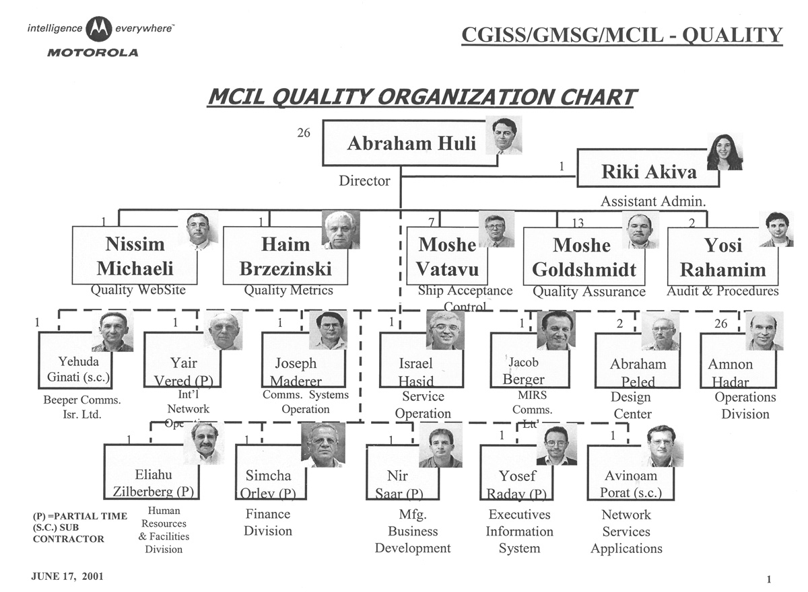

Slide 11
Quality of Life (*)
Health,
Peace
&
Freedom
Quality of Product
quality of Service
Personal Excellence
Organizational Excellence
National Excellence
Life
Time
Resources
Customer/
Citizen

Slide 12
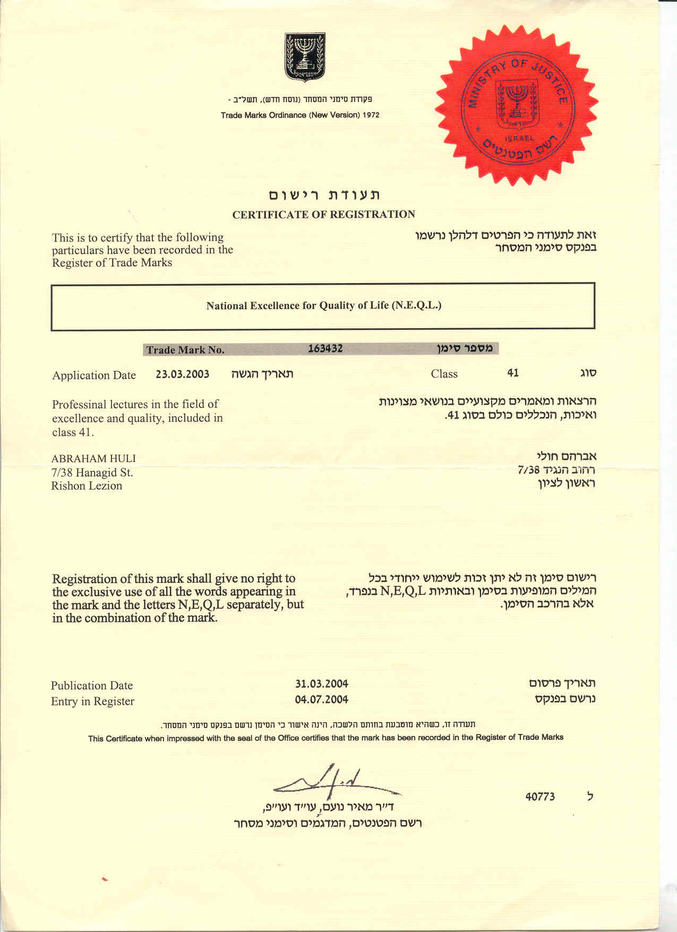

Slide 13
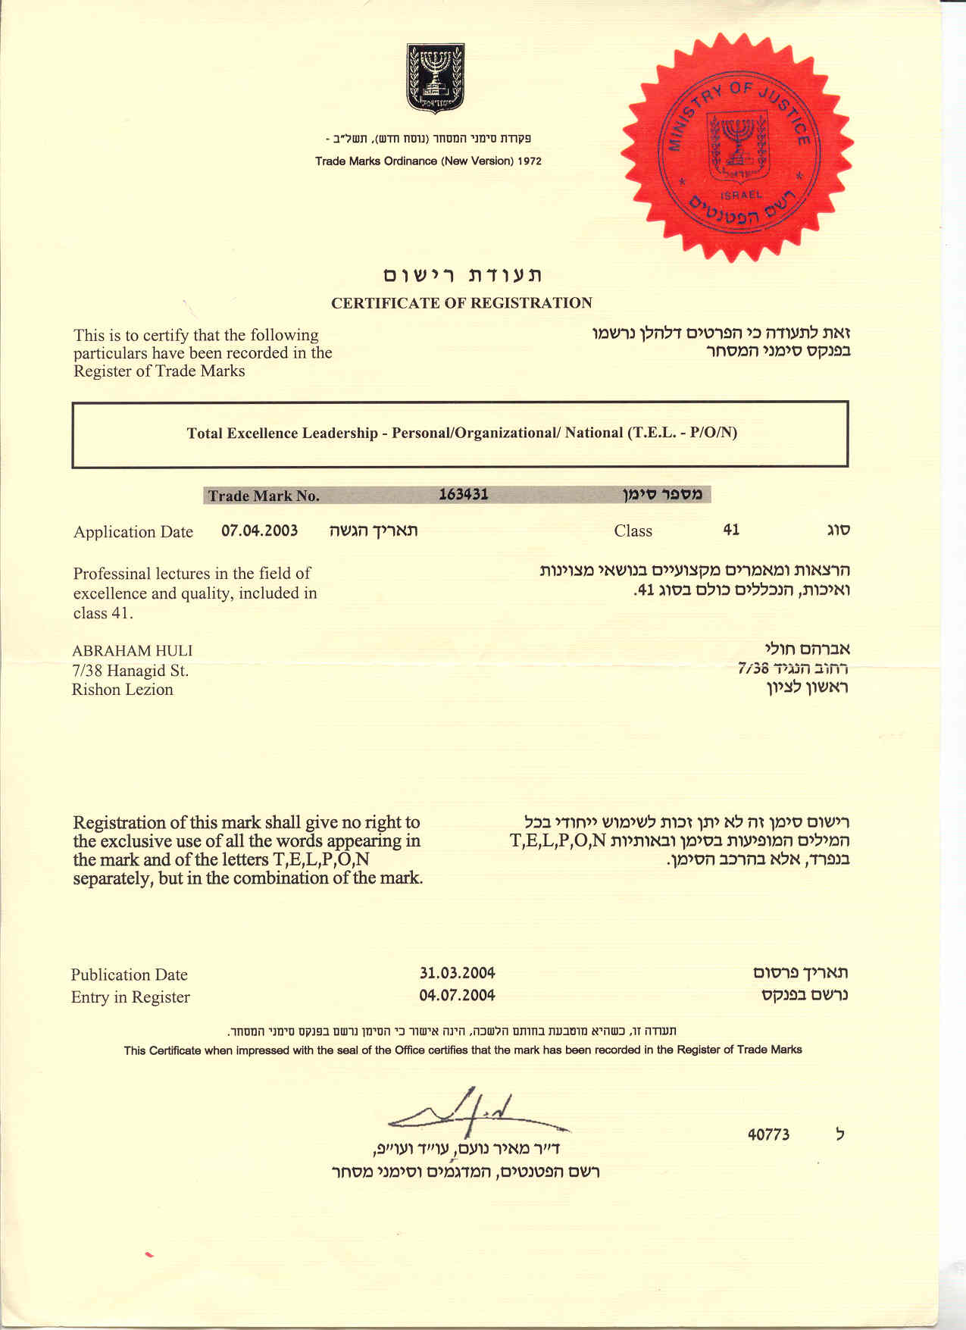

Slide 14


Slide 15
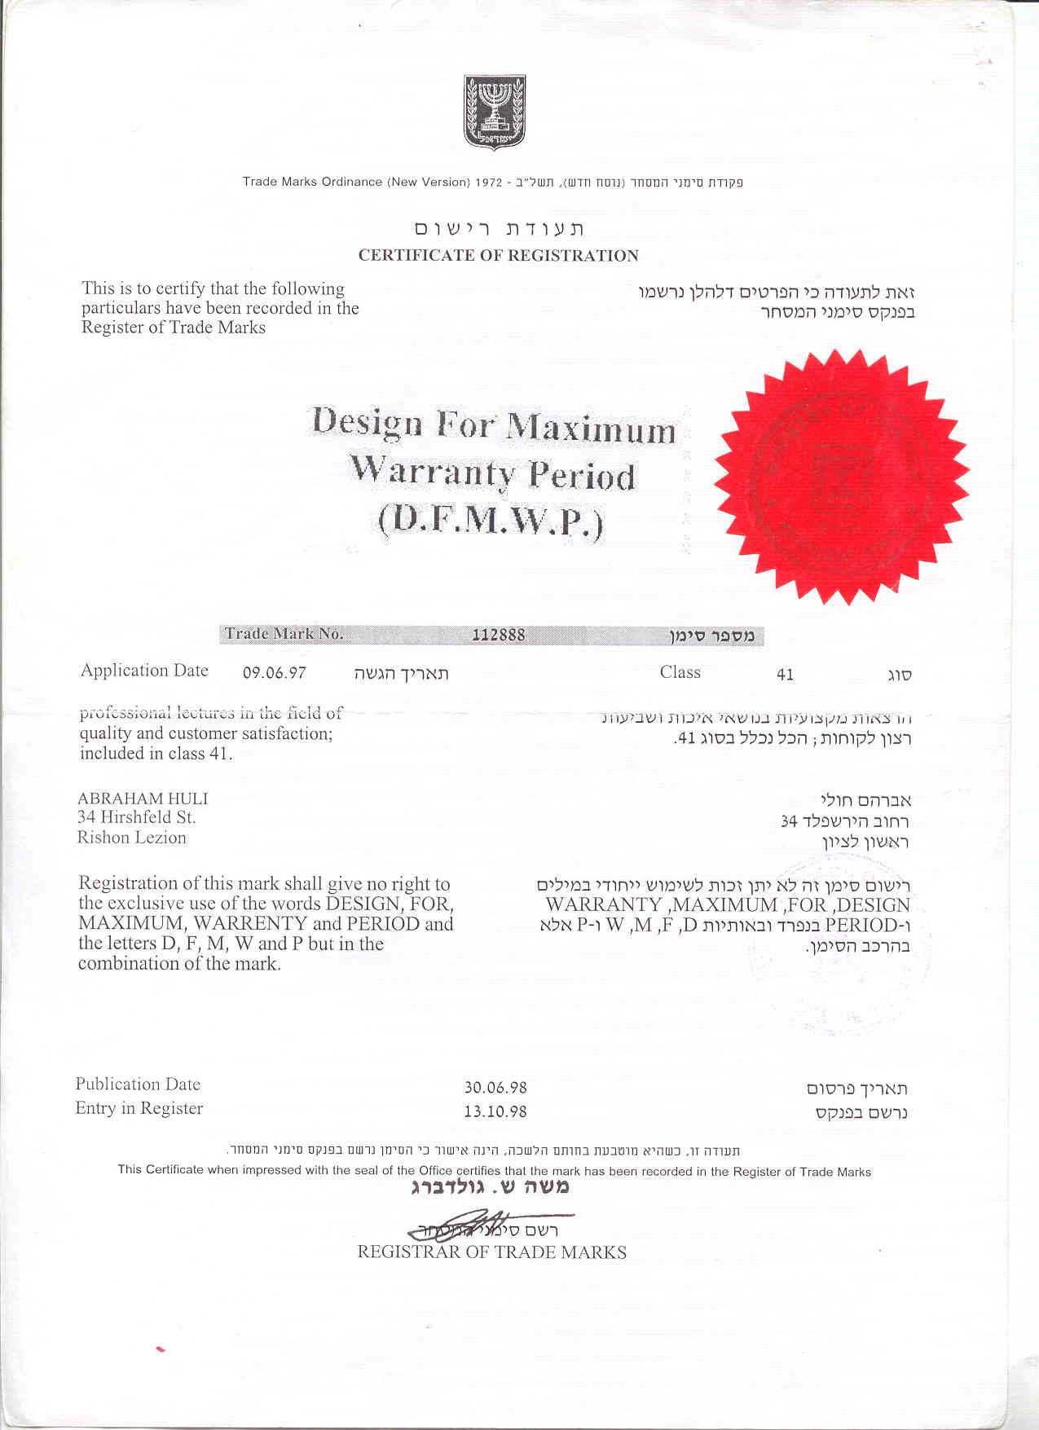

Slide 16
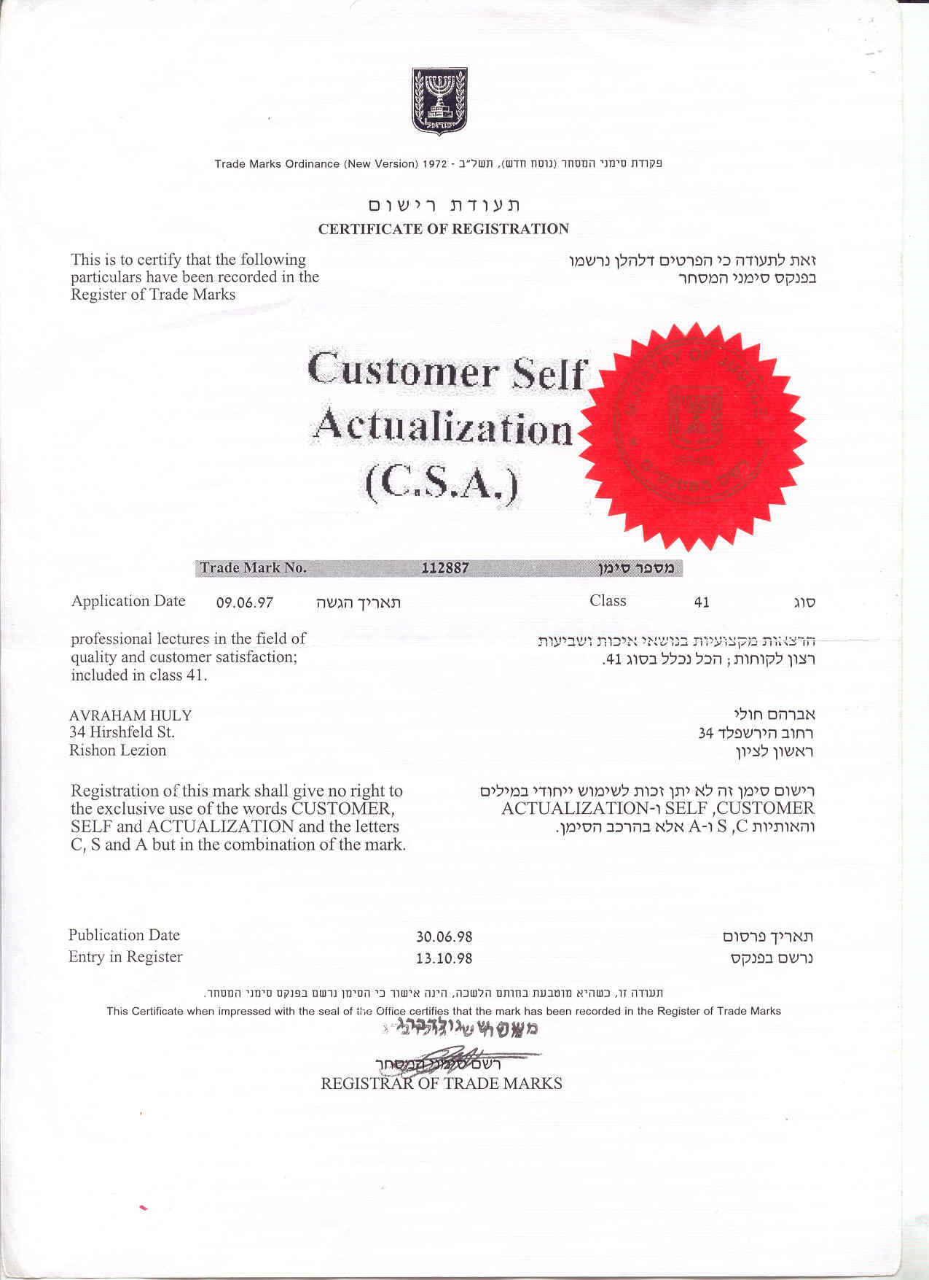

Slide 17
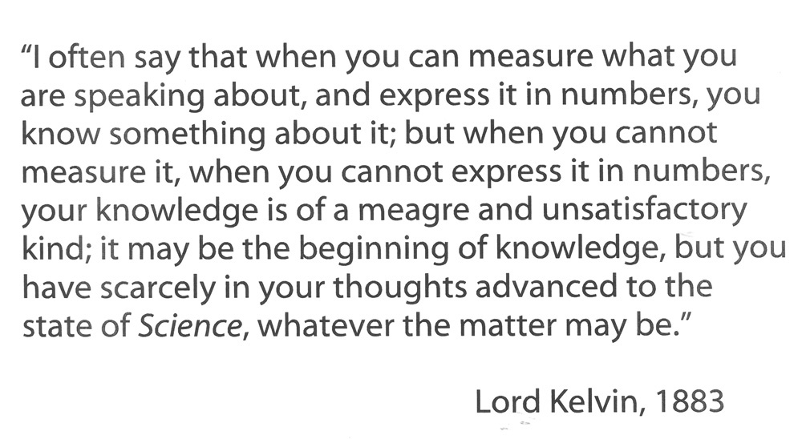
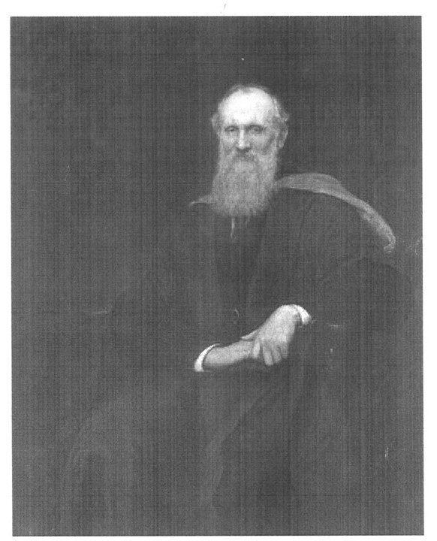

Slide 18
General Government Revenue Table
At current prices. Millions NIS (New Israeli Shekels)
 | 2001 | 2002 | 2003 | 2004 | 2005 | 2006 | 2007 | 2008 | 2009 | 2010 | 2011 | 2012 | 2013 | 2014 | 2015
Total Revenue of the General Government Sector | 242,979 | 252,549 | 245,910 | 252,438 | 266,014 | 291,886 | 305,579 | 304,336 | 296,524 | 327,229 | 350,772 | 363,948 | 391,934 | 411,476 | 435,058 | סה"כ הכנסות המגזר הממשלתי | 1+2
Current revenue | 237,728 | 246,788 | 240,949 | 246,684 | 260,208 | 285,171 | 298,663 | 295,673 | 288,385 | 316,812 | 339,912 | 352,782 | 379,226 | 398,530 | 420,969 | הכנסות שוטפות | 1
 | 15,516 | 16,187 | 16,374 | 16,341 | 17,156 | 17,807 | 19,630 | 20,475 | 20,120 | 22,157 | 24,313 | 26,302 | 26,426 | 28,184 | 28,344 | מכירות
Property income | 8,421 | 9,747 | 8,658 | 7,863 | 8,603 | 8,037 | 8,397 | 8,227 | 7,234 | 7,006 | 7,254 | 7,653 | 7,556 | 6,859 | 8,001 | הכנסה מרכוש | 1.1
Thereof: from the rest of the world | 204 | 200 | 174 | 170 | 186 | 228 | 207 | 124 | 115 | 74 | 22 | 24 | 22 | 21 | 23 | מזה: הכנסות מריבית מחו"ל
Taxes | 189,619 | 193,578 | 191,143 | 200,472 | 213,397 | 232,662 | 248,445 | 244,370 | 240,121 | 264,012 | 284,347 | 293,586 | 320,150 | 338,205 | 357,235 | הכנסות ממסים | 1.2
Taxes on production | 80,077 | 87,581 | 89,732 | 93,949 | 99,390 | 103,618 | 111,274 | 113,510 | 119,314 | 131,417 | 139,327 | 144,327 | 155,368 | 166,266 | 170,503 | מיסים עקיפים
Domestic | 58,341 | 64,941 | 67,960 | 68,953 | 72,716 | 76,090 | 78,891 | 81,877 | 88,187 | 96,414 | 101,740 | 106,978 | 117,343 | 123,174 | 128,601 | על ייצור מקומי
Import | 21,736 | 22,640 | 21,772 | 24,996 | 26,675 | 27,528 | 32,383 | 31,633 | 31,127 | 35,003 | 37,587 | 37,349 | 38,024 | 43,091 | 41,903 | על יבוא
Taxes on income and compulsory payments | 79,838 | 74,618 | 69,136 | 73,552 | 79,409 | 92,933 | 99,262 | 90,415 | 79,581 | 87,252 | 96,261 | 98,963 | 111,419 | 115,810 | 127,185 | מיסים ישירים ותשלומי חובה
National Insurance Contributions | 29,704 | 31,378 | 32,275 | 32,971 | 34,597 | 36,111 | 37,909 | 40,445 | 41,227 | 45,343 | 48,759 | 50,296 | 53,364 | 56,130 | 59,547 | הכנסות הביטוח הלאומי
Imputed Social Contributions | 6,607 | 6,925 | 6,553 | 6,794 | 6,716 | 7,026 | 6,926 | 7,520 | 7,570 | 7,929 | 8,253 | 8,476 | 8,730 | 8,515 | 8,527 | תשלומי פנסיה זקופים | 1.3
Current transfers | 17,565 | 20,352 | 18,222 | 15,215 | 14,337 | 19,639 | 15,265 | 15,082 | 13,340 | 15,708 | 15,746 | 16,766 | 16,363 | 16,767 | 18,863 | העברות שוטפות סה"כ | 1.4
Transfers from Households and Private NPI's | 1,073 | 1,105 | 1,070 | 1,247 | 1,300 | 1,385 | 1,425 | 1,755 | 1,672 | 1,799 | 1,764 | 1,948 | 2,097 | 2,144 | 2,220 | העברות ממשקי בית וממלכ"ר פרטיים
Transfers from the rest of the world | 16,492 | 19,247 | 17,152 | 13,968 | 13,036 | 18,255 | 13,840 | 13,326 | 11,668 | 13,909 | 13,982 | 14,818 | 14,266 | 14,623 | 16,643 | העברות מחו"ל סה"כ
 | 14,331 | 16,406 | 14,450 | 10,997 | 10,507 | 14,891 | 10,600 | 10,004 | 8,410 | 10,366 | 10,600 | 11,900 | 10,944 | 11,099 | 12,909 | העברות בינממשלתיות
 | 11,252 | 13,570 | 12,316 | 9,412 | 9,392 | 14,380 | 10,600 | 10,004 | 8,410 | 10,366 | 10,600 | 11,900 | 10,944 | 11,099 | 12,909 | מענק ביטחוני
 | 3,079 | 2,836 | 2,134 | 1,585 | 1,115 | 511 | 0 | 0 | 0 | 0 | 0 | 0 | 0 | 0 | 0 | סיוע אזרחי
 | 2,161 | 2,841 | 2,702 | 2,971 | 2,529 | 3,364 | 3,240 | 3,322 | 3,258 | 3,543 | 3,381 | 2,918 | 3,321 | 3,524 | 3,734 | העברות למוסדות לאומיים ולמלכ"ר ציבורי
Capital revenue | 5,252 | 5,762 | 4,961 | 5,754 | 5,805 | 6,715 | 6,916 | 8,663 | 8,139 | 10,418 | 10,860 | 11,166 | 12,708 | 12,946 | 14,089 | הכנסות ע"ח הון | 2
Capital Taxes | 1,115 | 995 | 946 | 1,531 | 1,727 | 1,977 | 2,368 | 2,505 | 2,485 | 3,525 | 3,879 | 3,380 | 3,745 | 3,509 | 3,709 | מסי הון
Capital transfers from the private sector | 3,648 | 4,054 | 3,395 | 3,673 | 3,631 | 4,157 | 4,068 | 5,706 | 5,269 | 6,424 | 6,585 | 7,545 | 8,598 | 9,093 | 9,923 | העברות הון מסקטור פרטי
Capital transfers from the rest of the world | 488 | 713 | 621 | 550 | 447 | 581 | 480 | 452 | 385 | 468 | 396 | 241 | 365 | 344 | 457 | העברות הון מחו"ל
Dr. Abraham Huli: www.huli.co.il

Slide 19
Taxes Table
At current prices. Millions NIS (New Israeli Shekels)
 | 2000 | 2001 | 2002 | 2003 | 2004 | 2005 | 2006 | 2007 | 2008 | 2009 | 2010 | 2011 | 2012 | 2013 | 2014 | 2015
סך כולל | 187,950 | 190,734 | 194,573 | 192,089 | 202,003 | 215,124 | 234,639 | 250,813 | 246,875 | 242,606 | 267,537 | 288,226 | 296,966 | 323,895 | 341,714 | 360,944 | GRAND TOTAL
מסים על הכנסה, תשלומים |  |  |  |  |  |  |  |  |  |  |  |  |  |  |  |  | TAXES ON INCOME, NATIONAL
לביטוח הלאומי ומסים שוטפים |  |  |  |  |  |  |  |  |  |  |  |  |  |  |  |  | INSURANCE CONTRIBUTION AND
אחרים - סך הכל | 103,992 | 106,982 | 103,614 | 99,251 | 103,225 | 109,895 | 124,628 | 131,948 | 126,120 | 116,841 | 127,101 | 138,838 | 144,367 | 158,828 | 165,509 | 177,882 | OTHER CURRRENT TAXES - TOTAL
1. מסים על הכנסה ומסים |  |  |  |  |  |  |  |  |  |  |  |  |  |  |  |  | 1. TAXES ON INCOME AND OTHER
שוטפים אחרים - סך הכל | 76,427 | 77,278 | 72,236 | 66,976 | 70,254 | 75,298 | 88,516 | 94,039 | 85,675 | 75,615 | 81,758 | 90,079 | 94,071 | 105,464 | 109,379 | 118,335 | CURRRENT TAXES - TOTAL
1.1 מס הכנסה - סך הכל | 73,264 | 73,901 | 68,260 | 63,261 | 65,291 | 71,041 | 84,083 | 89,324 | 80,913 | 71,058 | 76,354 | 84,759 | 88,590 | 99,643 | 103,495 | 111,655 | 1.1 Income tax - Total
(A)שכר | 45,278 | 48,662 | 46,618 | 41,520 | 39,886 | 40,108 | 42,483 | 45,507 | 43,215 | 39,141 | 40,172 | 42,817 | 43,415 | 46,856 | 50,746 | 53,915 | Wages(A)
חברות | 16,714 | 15,215 | 13,323 | 12,773 | 16,256 | 19,868 | 27,254 | 28,012 | 23,930 | 18,906 | 21,189 | 26,205 | 24,905 | 34,403 | 32,824 | 32,552 | Companies
עצמאים | 9,475 | 8,617 | 7,212 | 6,779 | 5,831 | 6,954 | 9,122 | 10,919 | 10,194 | 8,431 | 8,055 | 9,049 | 10,115 | 10,853 | 12,656 | 16,783 | Self-employed
ניכויים אחרים במקור | 1,797 | 1,407 | 1,107 | 2,189 | 3,318 | 4,111 | 5,224 | 4,886 | 3,574 | 4,580 | 6,938 | 6,688 | 10,155 | 7,531 | 7,269 | 8,405 | Other deductions at source
1.2 אגרות, היטלים וקנסות | 3,163 | 3,378 | 3,977 | 3,715 | 4,963 | 4,258 | 4,433 | 4,715 | 4,763 | 4,556 | 5,404 | 5,320 | 5,481 | 5,821 | 5,884 | 6,680 | 1.2 Fees, levies and fines
2. תשלומים לביטוח הלאומי |  |  |  |  |  |  |  |  |  |  |  |  |  |  |  |  | 2. NATIONAL INSURANCE
סך הכל | 27,565 | 29,704 | 31,378 | 32,275 | 32,971 | 34,597 | 36,111 | 37,909 | 40,445 | 41,227 | 45,343 | 48,759 | 50,296 | 53,364 | 56,130 | 59,547 | CONTRIBUTIONS - TOTAL
2.1 שכר - סך הכל | 16,315 | 17,618 | 18,796 | 19,723 | 19,989 | 20,962 | 21,541 | 22,233 | 23,319 | 23,520 | 26,148 | 28,312 | 29,132 | 31,238 | 32,918 | 35,127 | 2.1 Wages - Total
מזה: ע"ח העובד | 8,133 | 8,782 | 8,889 | 9,536 | 9,695 | 10,283 | 11,891 | 12,273 | 13,129 | 13,242 | 14,721 | 15,508 | 15,818 | 16,213 | 16,755 | 17,880 | Thereof: By Employees
(B)ע"ח המעביד | 8,182 | 8,835 | 9,908 | 10,187 | 10,294 | 10,679 | 9,650 | 9,960 | 10,190 | 10,278 | 11,427 | 12,805 | 13,313 | 15,026 | 16,163 | 17,247 | By Employers(B)
2.2 אחר | 1,488 | 1,533 | 1,699 | 1,701 | 1,672 | 1,783 | 2,012 | 2,220 | 2,550 | 2,712 | 2,905 | 3,033 | 3,047 | 3,204 | 3,421 | 3,639 | 2.2 Other
2.3 מס בריאות | 9,762 | 10,553 | 10,883 | 10,851 | 11,310 | 11,852 | 12,558 | 13,456 | 14,576 | 14,994 | 16,290 | 17,414 | 18,118 | 18,922 | 19,790 | 20,781 | 2.3 Health tax
3. מסים על ייצור |  |  |  |  |  |  |  |  |  |  |  |  |  |  |  |  | 3. TAXES ON DOMESTIC
מקומי - סך הכל | 56,684 | 58,341 | 64,941 | 67,960 | 68,953 | 72,716 | 76,090 | 78,891 | 81,877 | 88,187 | 96,414 | 101,740 | 106,978 | 117,343 | 123,174 | 128,601 | PRODUCTION - TOTAL
מס ערך מוסף | 27,638 | 29,446 | 33,406 | 34,127 | 32,974 | 34,024 | 35,657 | 37,116 | 40,196 | 43,000 | 47,342 | 50,603 | 53,056 | 61,173 | 64,990 | 68,282 | Value added tax
מסים על הוצאות שכר | 6,850 | 7,150 | 8,450 | 8,840 | 9,440 | 9,920 | 9,900 | 9,920 | 9,250 | 9,570 | 10,260 | 10,850 | 11,530 | 12,274 | 12,967 | 13,745 | Wages' tax
מע"מ מלכ"ר | 4,260 | 4,660 | 5,940 | 6,130 | 6,590 | 6,720 | 6,610 | 6,580 | 7,000 | 7,250 | 7,650 | 8,050 | 8,550 | 9,012 | 9,980 | 10,266 | Non-profits' tax
מע"מ שכר פיננסי | 1,340 | 1,290 | 1,210 | 1,460 | 1,500 | 1,750 | 1,890 | 1,840 | 1,850 | 2,020 | 2,310 | 2,450 | 2,580 | 2,870 | 2,606 | 3,060 | Financial compensation tax
מס מעסיקים | 1,250 | 1,200 | 1,300 | 1,250 | 1,350 | 1,450 | 1,400 | 1,500 | 400 | 300 | 300 | 350 | 400 | 392 | 381 | 419 | Employers' tax
מע"מ רווחים פיננסיים | 1,287 | 1,186 | 673 | 1,794 | 1,572 | 2,041 | 2,659 | 2,198 | 759 | 1,757 | 1,924 | 1,431 | 2,149 | 2,236 | 2,133 | 2,116 | Financial gains tax
מס קנייה | 662 | 384 | 404 | 371 | 372 | 436 | 396 | 287 | 233 | 229 | 291 | 307 | 305 | 457 | 394 | 450 | Purchase tax
מס טבק, בלו |  |  |  |  |  |  |  |  |  |  |  |  |  |  |  |  | Excises on tobacco and cement
מלט ומס בולים | 1,932 | 1,771 | 1,819 | 1,795 | 1,794 | 1,559 | 825 | 800 | 745 | 784 | 840 | 799 | 818 | 804 | 739 | 634 | and stamp tax
מס דלק | 5,666 | 5,701 | 6,739 | 7,286 | 7,919 | 8,755 | 10,097 | 10,590 | 11,852 | 12,714 | 14,637 | 15,118 | 15,628 | 15,876 | 16,362 | 17,007 | Fuel tax
מס רכוש | 442 | 180 | 161 | 139 | 138 | 322 | 101 | 52 | 53 | 45 | 48 | 82 | 57 | 59 | 95 | 44 | Property tax
(C)מסים אחרים | 811 | 847 | 750 | 838 | 861 | 1,006 | 968 | 1,026 | 1,126 | 1,260 | 1,341 | 1,583 | 1,592 | 1,792 | 1,872 | 2,017 | Other taxes(C)
מסים שנגבו ע"י הרשויות |  |  |  |  |  |  |  |  |  |  |  |  |  |  |  |  | local authorities
המקומיות | 11,397 | 11,677 | 12,539 | 12,771 | 13,883 | 14,653 | 15,487 | 16,903 | 17,663 | 18,828 | 19,731 | 20,966 | 21,843 | 22,673 | 23,621 | 24,306 | taxes
4.מסים על יבוא - סך הכל | 22,993 | 21,736 | 22,640 | 21,772 | 24,996 | 26,675 | 27,528 | 32,383 | 31,633 | 31,127 | 35,003 | 37,587 | 37,349 | 38,024 | 43,091 | 41,903 | 4. TAXES ON IMPORTS - TOTAL
4.1 יבוא אזרחי - סך הכל | 21,594 | 20,066 | 20,486 | 19,924 | 23,407 | 24,876 | 25,481 | 30,648 | 30,062 | 29,726 | 33,472 | 35,985 | 35,470 | 36,031 | 40,833 | 39,657 | 4.1 CIVILIAN IMPORTS - TOTAL
מס ערך מוסף | 10,865 | 9,995 | 10,333 | 9,859 | 11,642 | 12,424 | 12,792 | 15,254 | 15,100 | 14,953 | 16,784 | 18,151 | 17,981 | 18,483 | 20,715 | 20,465 | Value added tax
מכס והיטלים | 1,320 | 1,252 | 1,284 | 1,273 | 1,493 | 1,657 | 1,775 | 2,094 | 2,245 | 2,271 | 2,542 | 2,752 | 2,404 | 2,172 | 2,624 | 2,701 | Customs and levies
מסי קנייה ואחרים | 9,409 | 8,819 | 8,869 | 8,792 | 10,272 | 10,795 | 10,914 | 13,300 | 12,717 | 12,502 | 14,146 | 15,082 | 15,085 | 15,376 | 17,494 | 16,491 | Purchase and other taxes
4.2 יבוא ביטחוני | 1,399 | 1,670 | 2,154 | 1,848 | 1,589 | 1,799 | 2,047 | 1,735 | 1,571 | 1,401 | 1,531 | 1,602 | 1,879 | 1,993 | 2,258 | 2,245 | 4.2 DEFENCE IMPORTS
5. מסי נדל"ן (מסים שוטפים אחרים) | 3,045 | 2,560 | 2,382 | 2,159 | 3,298 | 4,111 | 4,417 | 5,223 | 4,740 | 3,966 | 5,494 | 6,182 | 4,892 | 5,955 | 6,431 | 8,850 | 5. Tax on real assets(Other current taxes)
מס שבח | 1,207 | 979 | 891 | 744 | 1,172 | 1,634 | 1,653 | 2,203 | 2,347 | 1,757 | 2,454 | 3,075 | 2,104 | 2,557 | 2,704 | 3,794 | Betterment tax
מס רכישה ומס מכירה | 2,178 | 1,830 | 1,739 | 1,648 | 2,463 | 2,884 | 3,189 | 3,488 | 3,162 | 2,937 | 4,051 | 4,147 | 3,724 | 4,532 | 4,979 | 6,755 | Property purchase tax and Sales tax
בניכוי קרן פיצויים | 340 | 249 | 248 | 233 | 337 | 407 | 425 | 468 | 769 | 728 | 1,011 | 1,040 | 936 | 1,134 | 1,252 | 1,699
6. מסי הון (רשויות מקומיות) | 1,236 | 1,115 | 995 | 946 | 1,531 | 1,727 | 1,977 | 2,368 | 2,505 | 2,485 | 3,525 | 3,879 | 3,380 | 3,745 | 3,509 | 3,709 | Capital Taxes ( local authorities)
Dr. Abraham Huli: www.huli.co.il

Slide 20
The indicator “I” does not include incomes such as:
1. Loans
2. Donations
3. Government Bonds
Dr. Abraham Huli: www.huli.co.il

Slide 21
Conversion Table of current prices to real prices
Year | Nominal Price (Millions) | Inflation | Real Price
2015 | 360,944 | 2145 | 168
2014 | 341,714 | 2158 | 158
2013 | 323,895 | 2149 | 151
2012 | 296,966 | 2115 | 140
2011 | 288,226 | 2081 | 139
2010 | 267,537 | 2011 | 133
2009 | 242,606 | 1958 | 124
2008 | 246,875 | 1895 | 130
2007 | 250,813 | 1812 | 138
2006 | 234,639 | 1803 | 130
2005 | 215,124 | 1765 | 122
2004 | 202,003 | 1742 | 116
2003 | 192,089 | 1749 | 110
2002 | 194,573 | 1737 | 112
2001 | 190,734 | 1644 | 116
2000 | 187,950 | 1626 | 116
1999 | 165,544 | 1608 | 103
1998 | 151,126 | 1529 | 99
1997 | 140,195 | 1450 | 97
1996 | 122,536 | 1330 | 92
1995 | 107,251 | 1195 | 90
1994 | 92,233 | 1086 | 85
1993 | 74,897 | 967 | 77
1992 | 64,071 | 872 | 74
1991 | 52,717 | 779 | 68
1990 | 41,323 | 654 | 63
1989 | 33,684 | 558 | 60
1988 | 30,615 | 464 | 66
1987 | 26,096 | 399 | 65
1986 | 20,701 | 333 | 62
1985 | 12,630 | 225 | 56
1984 | 2,829 | 56 | 51
1983 | 687 | 12 | 59
1982 | 260 | 5 | 54
1981 | 110 | 2 | 51
1980 | 47 | 1 | 47
Based on 1980 normalized inflation
Dr. Abraham Huli: www.huli.co.il

Slide 22
Changes calculations table of 5 years moving average of real income per capita. Related to 1984
Dr. Abraham Huli: www.huli.co.il

Slide 23
Chart of the % Improvement
of the 5 years moving average of real income per capita. Related to 1984

Slide 24
Quality of Life
citizens survey
Link to citizens survey 2003 (example)
Dr. Abraham Huli: www.huli.co.il

Slide 25
By observing the table it can be noticed that there is a common trend between the two indicators:
when the results of the "excellence indicator" (the economic indicator) are higher, so are the results of the "quality of life indicator" (the social indicator).
When there is a decline in the economic indicator, it is also expressed in the social indicator, i.e.: the satisfaction of the residents decreases.
http://www.cbs.gov.il/www/publications/tec21_e.pdf

Slide 26
From: amichai@mof.gov.il
Sent: 14 October 2013 13:24
To: Abraham Huli
Subject: Fiscal Data-Base
Here's a short description of the duties of the economics and knowledge management department in the chief economist's division.
The department is active in several areas among which are the following:
Erecting the infrastructure needed for decision making for the macro economic policy of Israel; by creating tools for decision making, research projects, professional reviews and international comparisons, data analyses and presenting trends, and providing various research services to the Minister of the Treasury, the General Manager of the Ministry and, as needed, to various departments in the Ministry.
Managing economic information in the Ministry of the Treasury while securing, managing, storing and distributing information on issues of macro economy, ongoing reviews of developments, conducting economic research projects and strengthening the ties of the Ministry of the Treasury with the academic world.
Supporting governmental fund acquisitions in capital markets in Israel and the world including preparing State of Israel prospectuses and during meetings with credit rating agencies.
Leading in providing international information in macro economics and managing the Ministries web site in English, maintaining ongoing contact with consuls abroad jointly with the Ministry of Economics and the Foreign Office, participating in organizing conferences and distributing publications marketing the State of Israel in the international arena to strengthen image and attract investors.
Responsible for the links of the State of Israel and the Ministry with international macro economic institutions (the International Monetary Fund, G-20, OECD)
Data bases including the parameters that you send to us are central performance tools in performing the department's duties.
Respectfully,
Amichai Fishler
Treasury Economics and Research

Slide 27
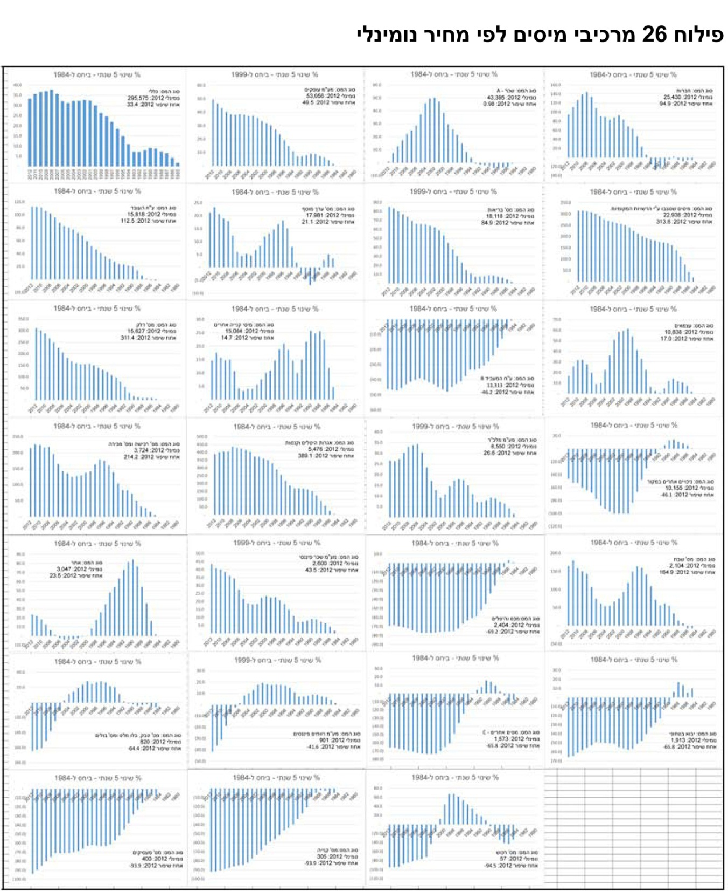
Pareto of the 26 tax type by diminishing nominal price
Dr. Abraham Huli: www.huli.co.il

Slide 28
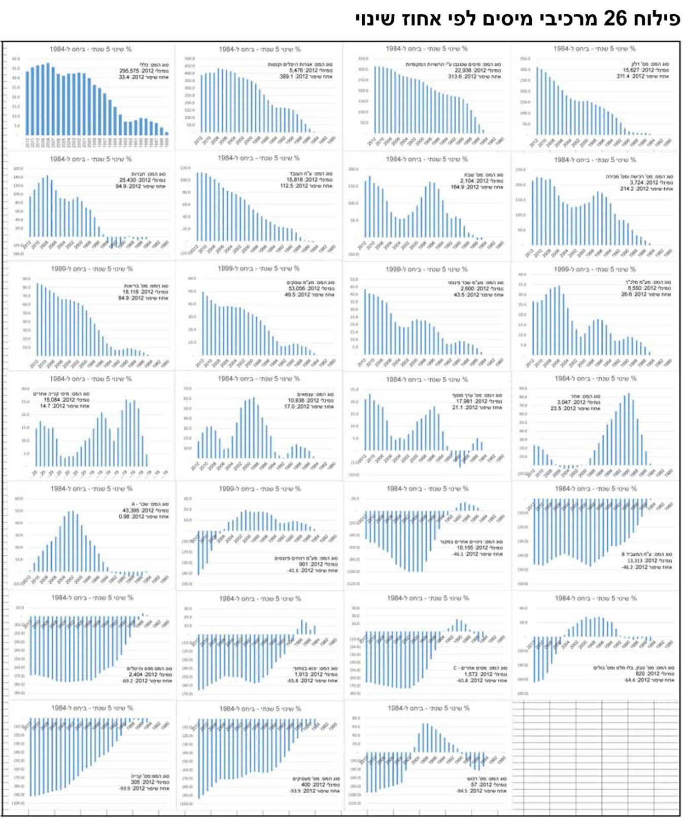
Pareto of the 26 tax type by diminishing % improvement
Dr. Abraham Huli: www.huli.co.il

Slide 29
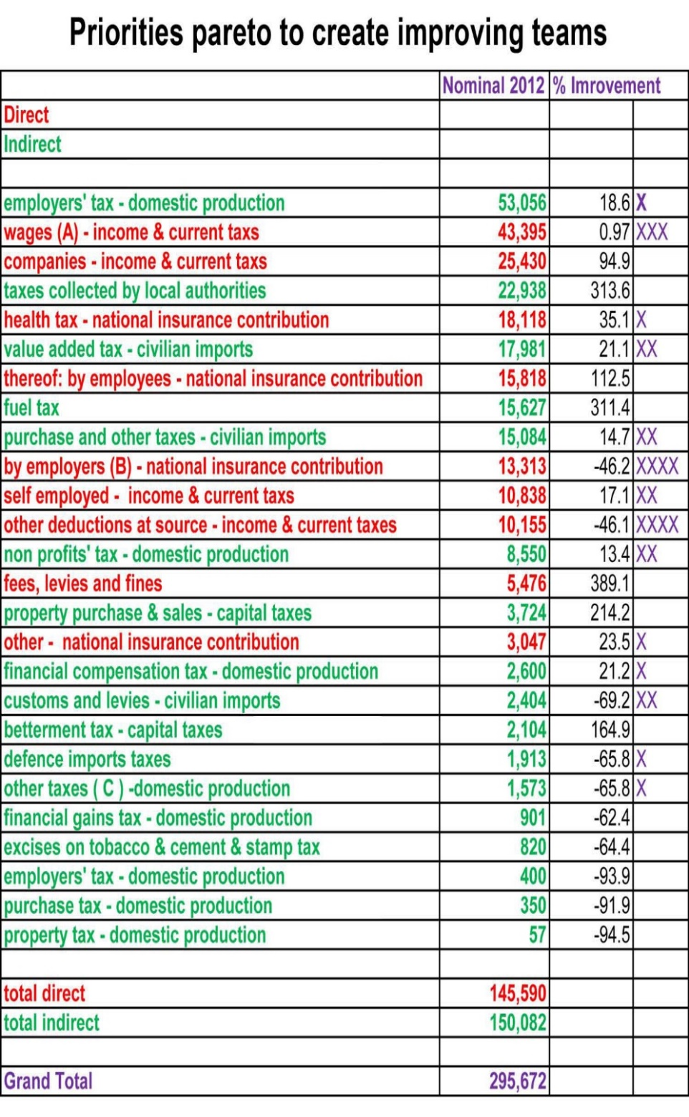
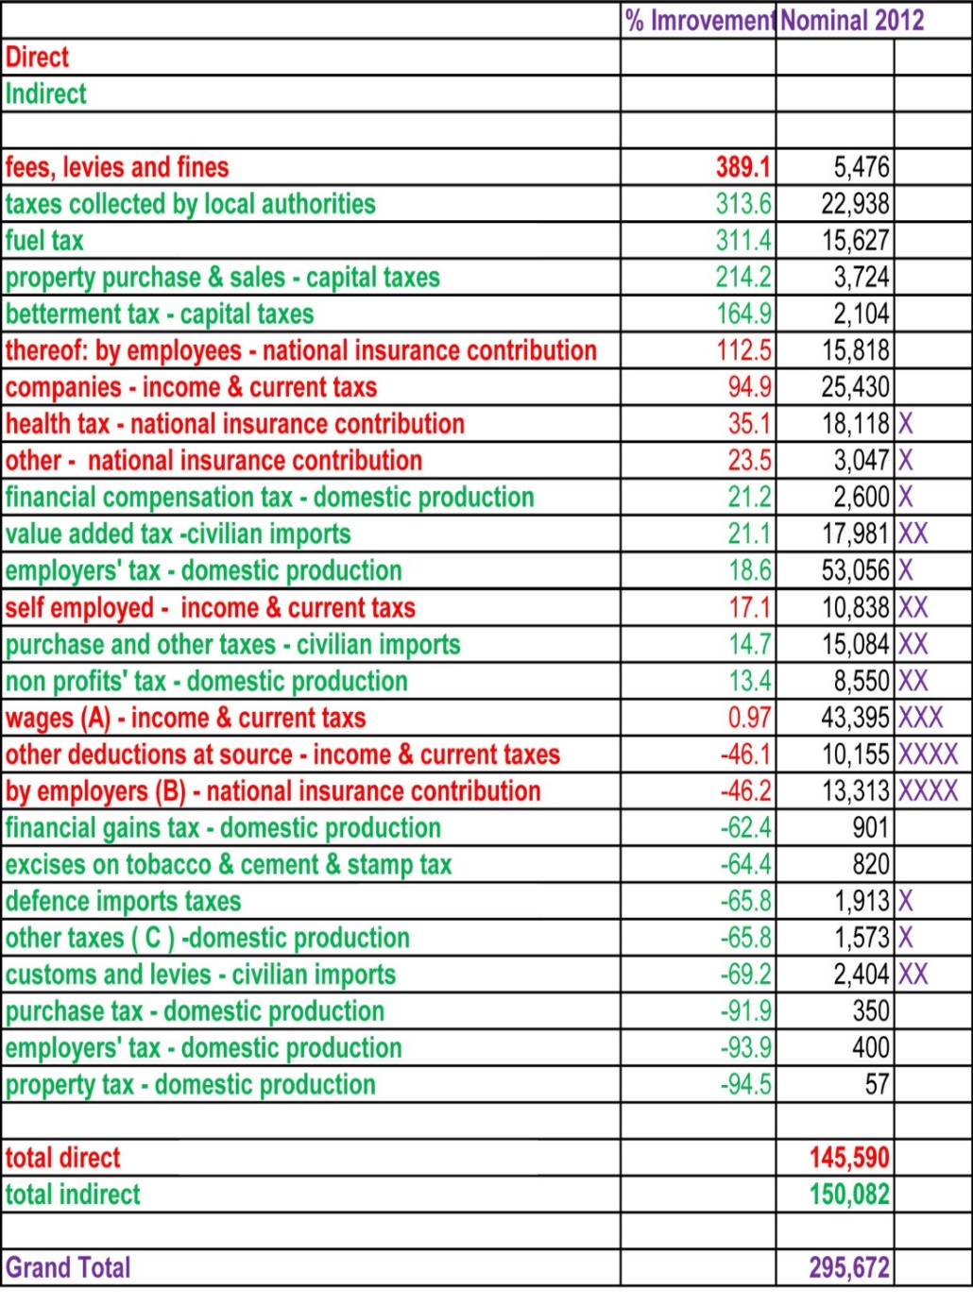

Slide 30
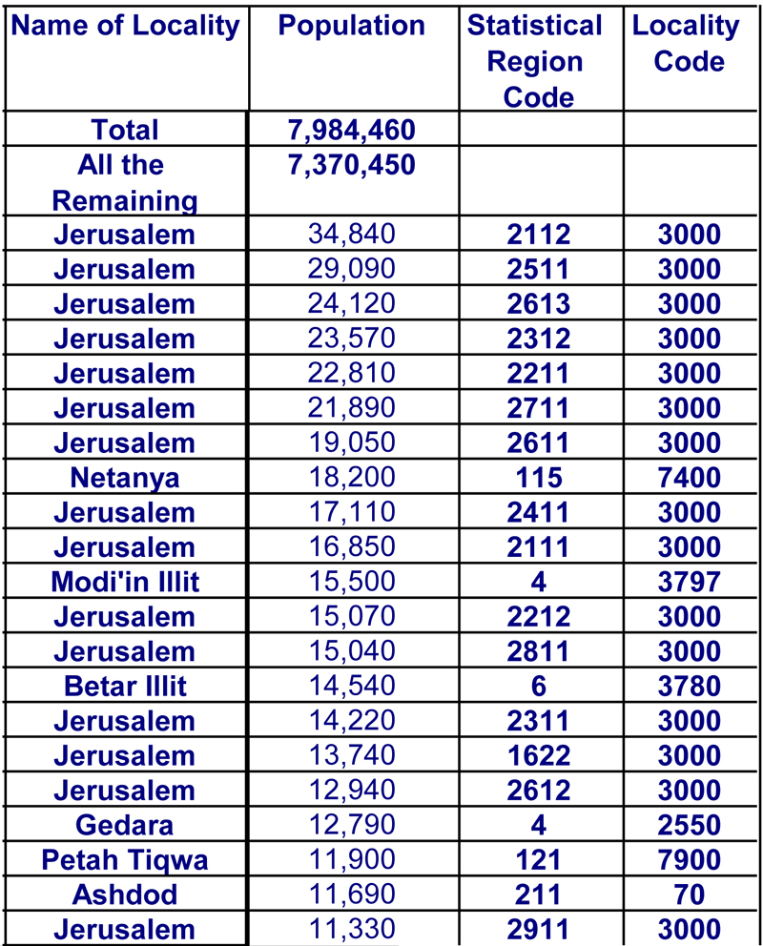

Population of
Israel in the
49 largest statistical regions
End of 2012,
Rounded off to tens
Note: In making use of the data, please take into account that smaller numbers have less reliability and more of a chance of error.

Slide 31
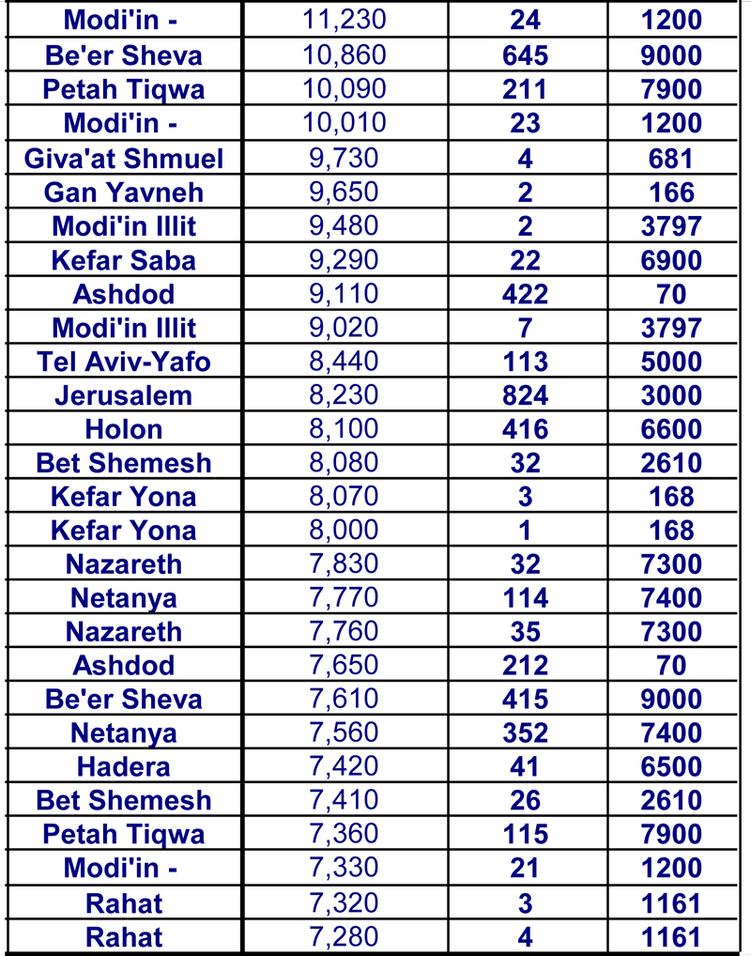
Cont. Population of
Israel in the
49 largest statistical regions
End of 2012,
Rounded off to tens
Note: In making use of the data, please take into account that smaller numbers have less reliability and more of a chance of error.

Slide 32
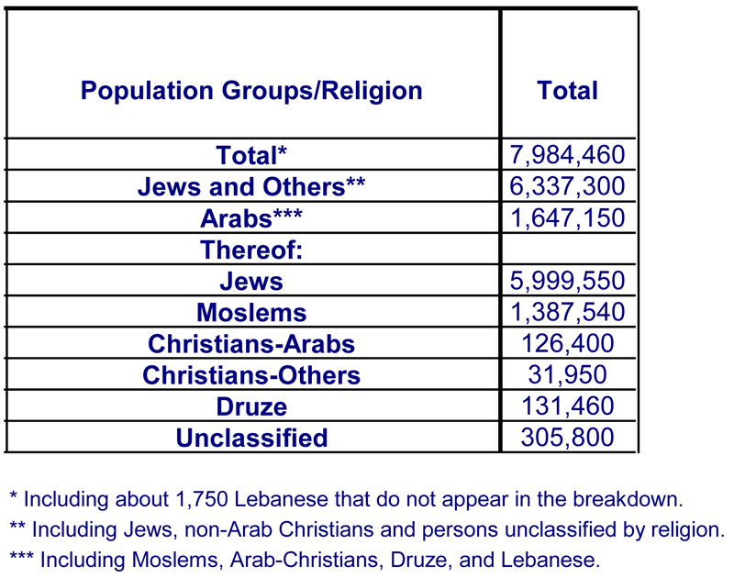
Population of Israel by Population groups and
Religion
End of 2012,
Rounded off to tens
Note: In making use of the data, please take into account that smaller numbers have less reliability and more of a chance of error.

Slide 33
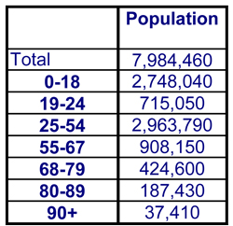
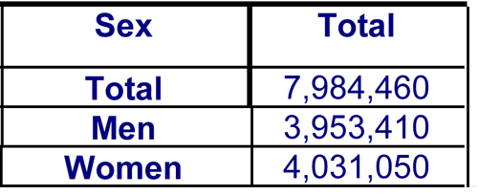
Population of Israel by
age group
End of 2012, Rounded off to tens
Population of
Israel by sex
End of 2012,
Rounded off to tens
Note: In making use of the data, please take into account that smaller numbers have less reliability and more of a chance of error.

Slide 34
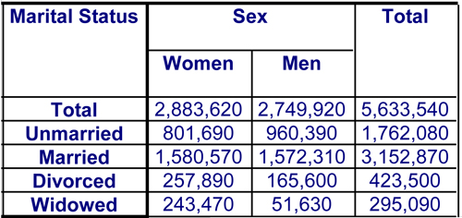
Population of
persons aged 15 and over, by martial status and sex
End of 2012,
Rounded off to tens
Note: In making use of the data, please take into account that smaller numbers have less reliability and more of a chance of error.

Slide 35
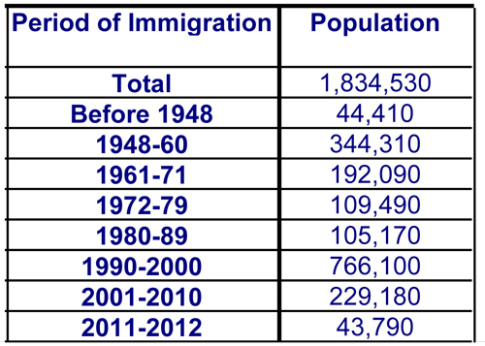
Population of
immigrants by period of immigration
End of 2012,
Rounded off to tens
Note: In making use of the data, please take into account that smaller numbers have less reliability and more of a chance of error.

Slide 36
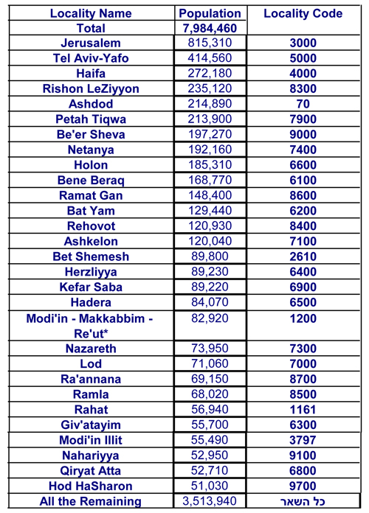
Population of
Israel in the
29 largest localities
End of 2012,
Rounded off to tens
Note: In making use of the data, please take into account that smaller numbers have less reliability and more of a chance of error.

Slide 37
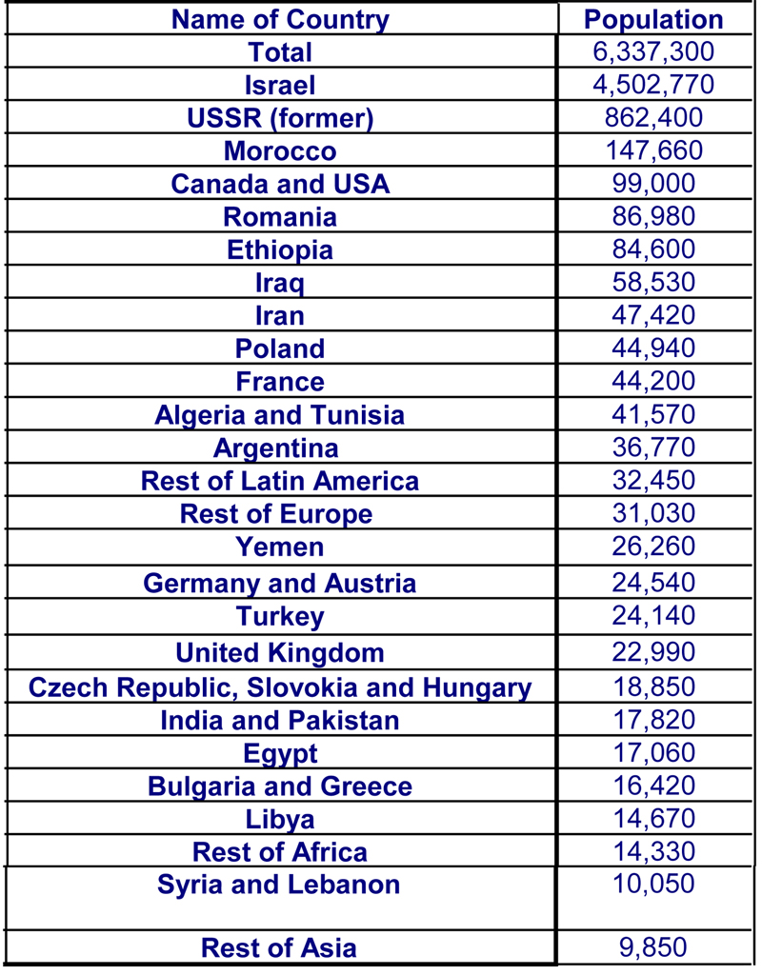
Population of
Jews and others, by country of birth
End of 2012,
Rounded off to tens
Note: In making use of the data, please take into account that smaller numbers have less reliability and more of a chance of error.

Slide 38
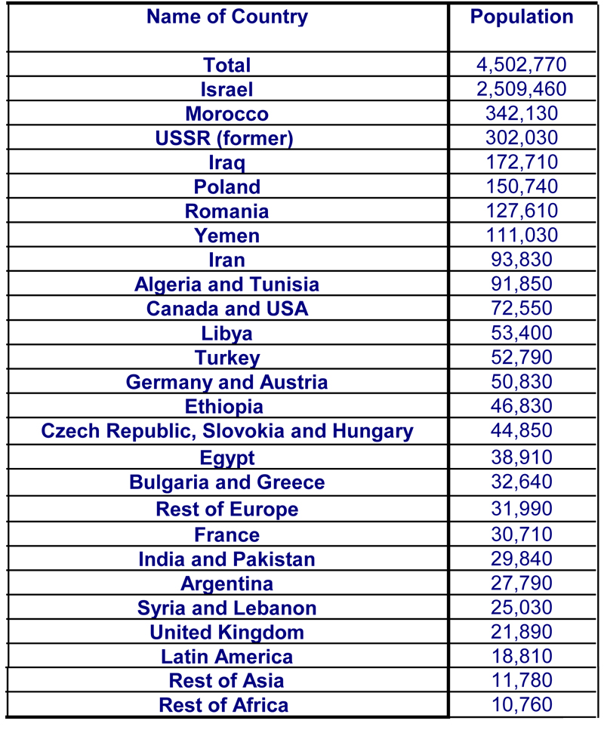
Population of
Jews and others born in Israel, by father’s country of birth
End of 2012,
Rounded off to tens
Note: In making use of the data, please take into account that smaller numbers have less reliability and more of a chance of error.

Slide 39
Chart of the % gap
of the 5 years moving average of real income per capita. Related to 1984.

Slide 40
Lack Excellence Vs. Excellence
Excellence
% Increase / Improve
A(%) = (96-95)/95 * 100 = 1.0526%
B(%) = (97-96)/96 * 100 = 1.0417%
C(%) = (98-97)/97 * 100 = 1.0309%
D(%) = (99-98)/98 * 100 = 1.0204%
99
100
98
99
97
%
98
96
97
95
96
95
A
B
C
D
% Decrease / Reduce
A(%) = (5-4) / 5 * 100 = 20%
B(%) = (4-3) / 4 * 100 = 25%
C(%) = (3-2) / 3 * 100 = 33.3%
D(%) = (2-1) / 2 * 100 = 50%

Slide 41
Excellence Quality
Organization Customer
How To Achieve Aggressive Goals
PREVENTION CULTURE
BY IMPROVEMENT OF :
PROCESSES
&
METHODS
&
TOOLS
&
PERSONAL EXCELLENCE
&
ORGANIZATIONAL EXCELLENCE
&
NATIONAL EXCELLENCE
TEAM WORK

Slide 42
Quality Is Our “M”(Mother) Tongue (Language)
SYSTEMATIC APPROCH TO PROBLEM SOLVING:
“THE TEN COMMANDMENTS“
PROBLEM IDENTIFICATION & TEAM SET UP
PROBLEM DEFINITION WITH CUSTOMER INPUTS
DATA COLLECTION
DATA PROCESSING
PROBLEM ANALYSIS
IDEAS (ALTERNATIVES) FOR SOLUTION
EVALUATION AND SELECTION OF THE PREFERED SOLUTION
PLANNING OF IMPLEMENTATION
IMPLEMENTATION AND CUSTOMER FEEDBACK
INSTITUTIONALIZATION AND CONTROL
PREPARING TEAM PRESENTATION TO TOP MANAGEMENT

Slide 43
Excellence Quality
Organization Customer
Excellence
Excellence is defined as outstanding practice in managing the organization and achieving results, all based on a set of 8 fundamental concepts.
Organizational Excellence
Organizational excellence is achieved by integrating various approaches, such as quality management principles along with cost management, and eliminating barriers of communication.
EFQM'S Vision (for Europe):
A world in which organizations in Europe excel.
EFQM'S Mission (for EFQM):
To be the driving force for sustainable excellence in organizations in Europe.
EFQM'S Values:
We, as the Members and employees of the EFQM
  Strive for organizational excellence

Slide 44
Objectives of change:
To amplify and improve the dimensions of the positive phenomenon / success – what has been done.
To reduce and minimize the dimensions of a negative phenomenon / failure – what should be done.

Slide 45
Every organization, commercial or public, and human being – during all his life, conducts a broad range of activities on a daily basis. The goods and services, provided by organization or mankind, reach a wide spectrum of intended recipients; him/herself, employees, customers, suppliers, communities and more.
Measuring the results of those activities is prerequisite to knowing if they were successful and to what degree. Measurement alone is not enough to provide the knowledge of whether more could be achieved. Two main activities are recommended:
Analyzing the reasons underlying faults, failures, deficiencies and other manifestations of why greater success was not achieved.
Planning improvement and preventive actions, based both on successes of others in similar circumstances and with the hope that they also measure their successes and publish them, so that others may learn.

Slide 46
To summarize and conclude:
Background
Data
Population: 8.4 Million
Money: 114 billion US dollars
Time: 31 years
Improvement: 43.7%
:examples of life quality improvement
number / percentage of population travelling abroad
number / percentage of children participating in educational programs
Number / percentage of automobiles per resident / family

Slide 47
Based on the model shown here today, it is possible to estimate that:
"The quality of life of Israelis has improved during the past 31 years (1984 – 2015) by 43.7% !!!”

Slide 48

“The Race for Excellence
has no Finish Line”

Slide 49
I recommend and encourage you,
to initiate a similar process –
as I presented you here today,
in order to develop a
“National Excellence & Quality of Life” Indicator, also in your country!!!

Slide 50

Thank You
www.huli.co.il

Slide 51
Questions???
Answers!!!

Slide 52
Gross domestic product (GDP)
Net domestic product (NDP (
Gross national income (GNI (
Net national income (NNI)
Primary incomes (PI)

Slide 53
The term: Gross domestic product (GDP)
Other names: GDP at market prices, Gross domestic product, GDP
Subject: National Accounts
Definition:
The sum of the gross values added of all resident producers (output less intermediate consumption), plus any taxes
less subsidies on products not already included in the value of output. GDP is also derived as the sum of expenditure
on final consumption plus gross capital formation plus exports less imports. In addition GDP is derived as sum of
primary incomes distributed by resident producer units: compensation of employees plus gross operating surplus
plus gross mixed incomes plus taxes less subsidies on both production and imports.

